Slide 1
TED Dynamic chart component
Architecture
Features
Estimation

Slide 2
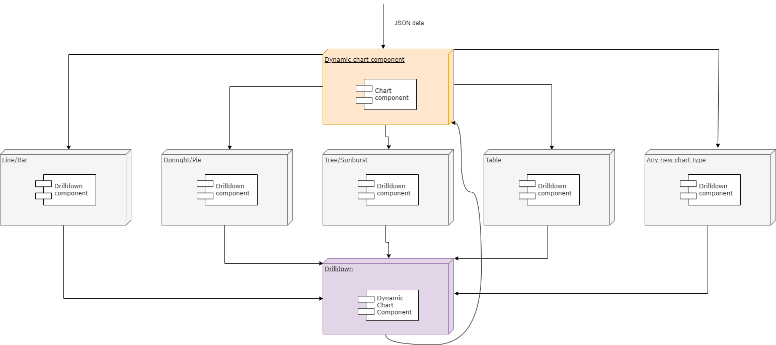
Architecture

Slide 3
Features
Export
PDF (Contains documentation of metric, and chart picture)
PNG(Contains chart picture)
Excel(Contains data and chart picture)
Fullscreen mode
Changing chart type line to bar and vise versa
Stacking for mixed charts
Reset
Color picker (coming soon)
Date filter (Beta)
Notes(ONHOLD)
Screen Occupancy (specifies the number of columns a chart needs to occupy)

Slide 4
Libraries Used
Echarts for rendering charts,
jsPdf for PDF export,
Excel.js for Excel export
Html2canvas for PNG export
Angular Material for components
File-saver to save files

Slide 5
Estimation to migrate to vuejs
Feature | Estimation
Chart components (other than table) | 1 day
Drilldown | 1 ½ day
Table components | 1 day
Multi-chart component | ½ day
Features | 2 days(If all libraries available for vuejs)
Service integration (If needed) | 1 day
Dashboard component (If needed) | 2days

Slide 6

Thank you!

